Slide 1
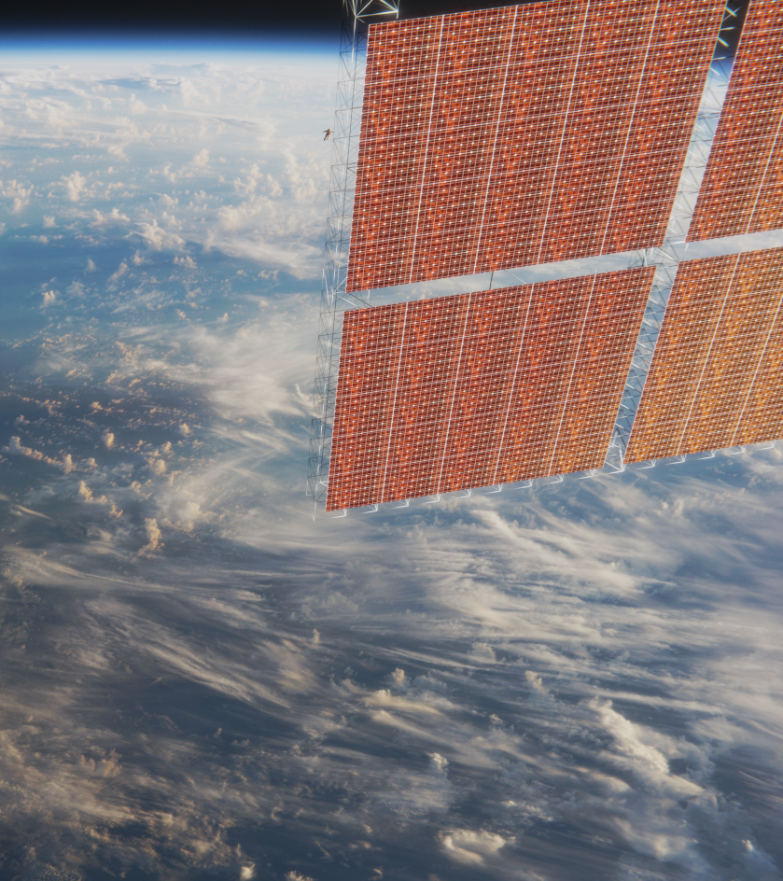

Media Kit

Slide 2
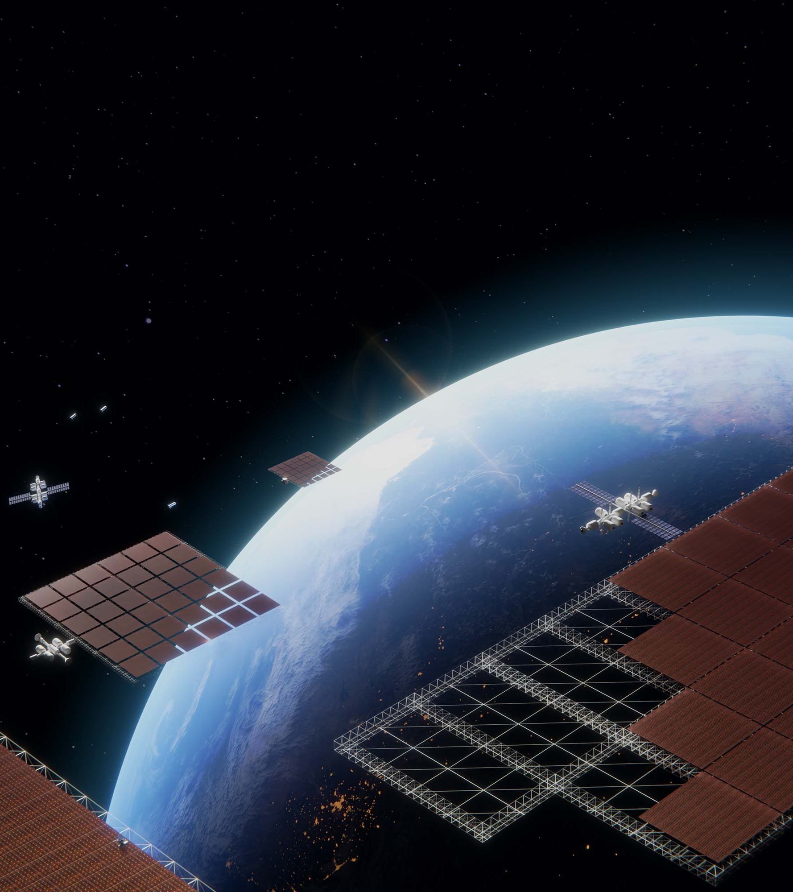
Company
Solestial, Inc. exists to deliver abundant energy in space. Our breakthrough technology is a silicon solar cell engineered for space to self-cure radiation damage under sunlight at operating temperatures as low as 65°C. Solestial solar cells are packaged in an ultrathin, low mass, flexible solar power module designed to withstand up to 10 years in a variety of destinations in space. Our flexible solar power modules can be produced on automated machines resulting in costs 90% lower than traditional III-V multijunction solar products. By the end of 2024, we will be producing silicon photovoltaics for space at a run rate of 1 MW, a scale comparable to the annual global capacity of all III-V solar manufacturers combined. From today’s satellite constellations and research projects to tomorrow’s lunar settlements and services in space, Solestial’s innovative technology represents a paradigm shift for space solar; an affordable, scalable solution to power sustained development.

Slide 3
Product
Solestial’s core product is a flexible solar power module. Each flexible solar power module is comprised of silicon solar cells engineered for space. Our modules are ultrathin, low mass, and radiation hardened.
Affordability and scalability are the key differentiators of Solestial modules. They are 10 times more affordable than III-V multijunction solar panels and can be quickly manufactured on automated machines.
Terrestrial silicon solar panels are affordable but degrade rapidly in space due to radiation and other factors. Solestial flexible solar power modules anneal radiation damage at normal operating temperatures allowing them withstand up to 10 years in a variety of destinations in space.
Solestial’s innovative solar products provide customers with the best combination of radiation hardness, performance, and cost, at virtually unlimited scale.
Solestial Flexible Solar Power Module

Slide 4
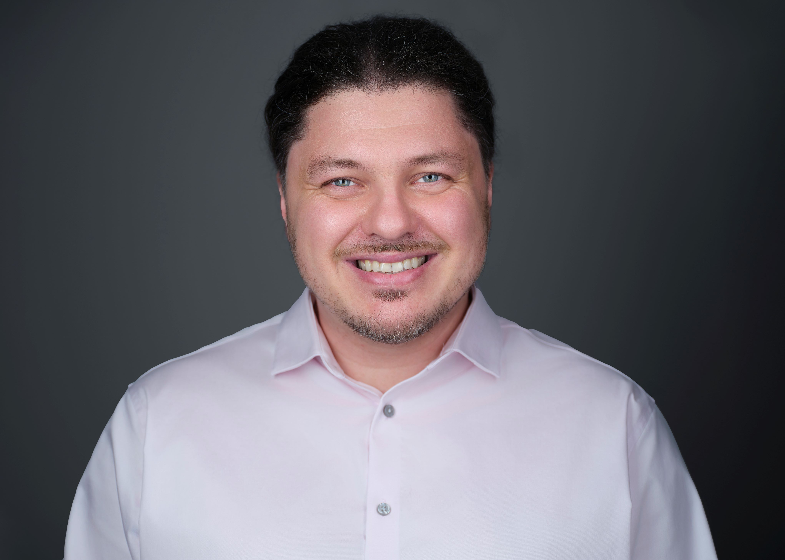
Bio
Stanislau “Stan” or “Stas” Herasimenka is CEO and Co-Founder of Solestial, where he is responsible for Strategy, Product, and Technology Development. Based in Tempe, Arizona, Stan has more than 15 years’ experience working with solar cells. Through his research, he has led the development of Solestial’s foundational technology, radiation tolerant silicon solar cells.
Stan graduated from Belarusian State University with a BS in Physics. After graduation, he moved to the United States and began working with solar cells. Through his work, he met future Solestial co-founder Mikhail Reginevich. In 2011, the pair began collaborating on ultrathin silicon solar cell technology at Arizona State University where Stan was pursuing a PhD in Electrical and Electronics Engineering. After graduating in 2013, Stan and Mikhail founded Regher Solar, deriving the company’s name from a combination of their last names.
Stan is passionate about photovoltaics. Through his continued research, his mission is for Solestial to become the solar energy company for space, providing technologies that will ultimately benefit life on earth.

Slide 5
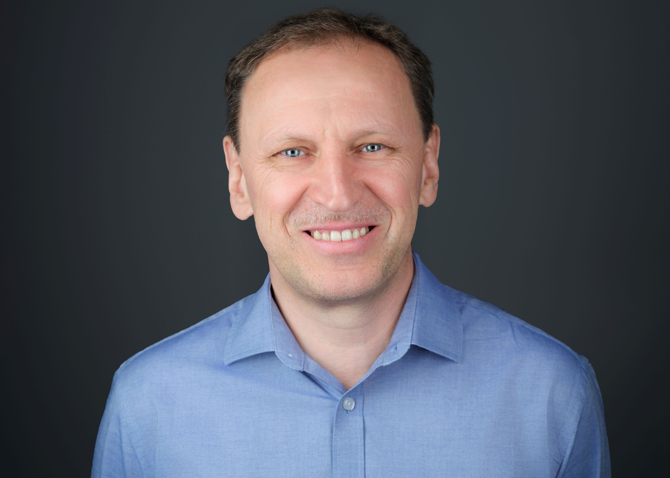
Bio
Mikhail Reginevich is CTO and Co-Founder of Solestial, where he is responsible for Packaging, Production, Manufacturing, and Technical Operations. Mikhail has more than 30 years’ experience in semiconductor manufacturing and engineering management. His experience is broad, and includes the areas of integrated circuit packaging, silicon epitaxy, solar wafer technology, and solar cell fabrication.
Previously, Mikhail served as Co-Founder, CEO, and CTO of Solar Group, a Belarusian solar cell manufacturing company. During his five-year tenure at Solar Group, he produced more than 15 MW of solar cells and 10 MW of solar wafers for the European market.
Mikhail has served as a technical advisor to several leading terrestrial photovoltaic manufacturers in the eastern European region. He has an MS in Semiconductor Manufacturing Technology from Belarus National Technical University.

Slide 6
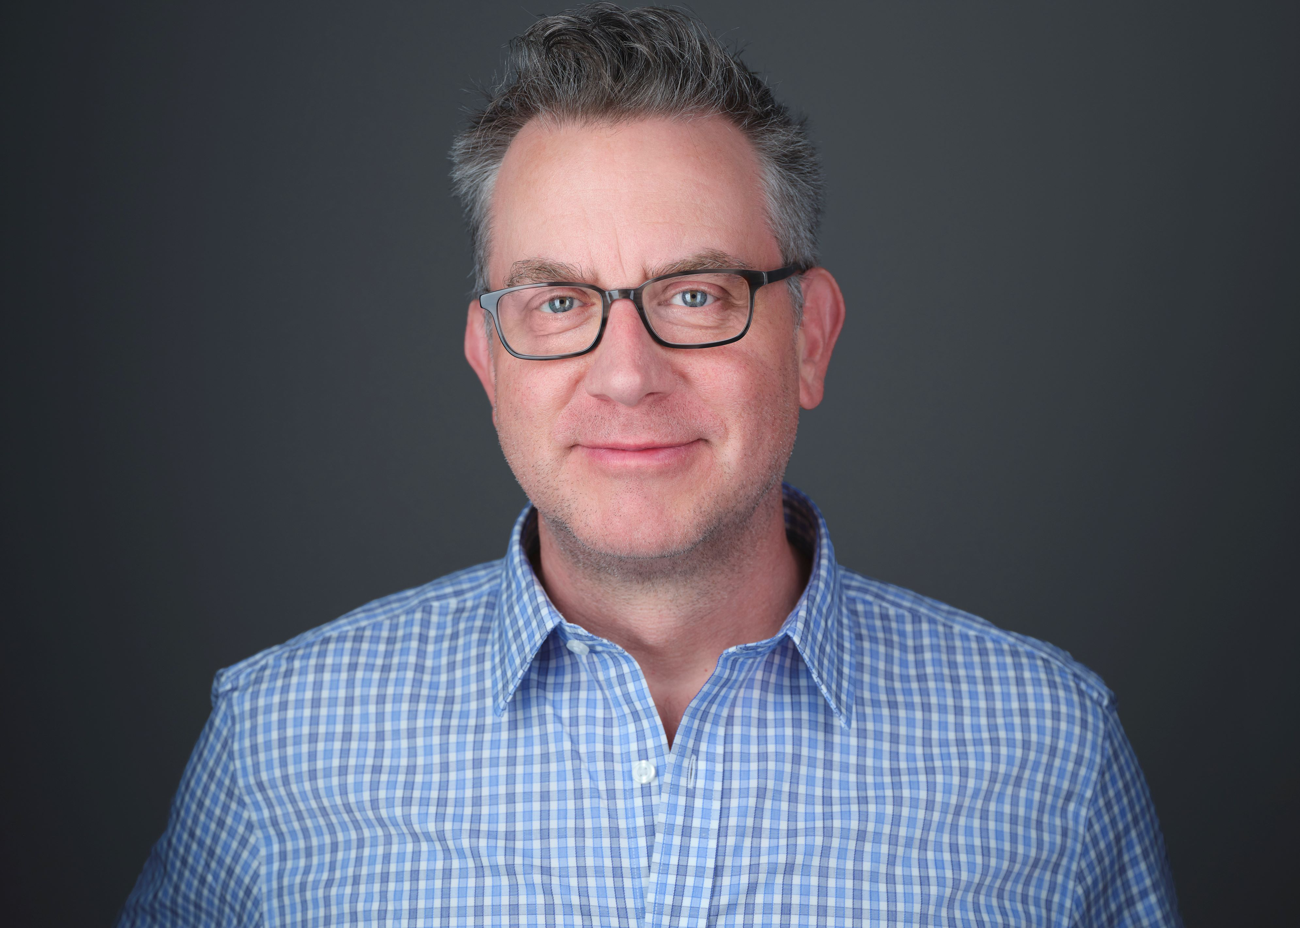
Bio
Andy Atherton is COO of Solestial, responsible for Sales, Marketing, Finance, and non-technical Operations. Based in the Bay Area, Andy has more than twenty years’ experience working in executive leadership roles at technology companies, including Healthline and AppNexus, where he served as Senior Vice President and General Manager, and at Yahoo! where he was a Vice President. Andy’s experience also includes C-level roles at three “from scratch” start-ups, serving as Co-Founder at two, C-level advisory roles at several other start-ups, and four years of technology-focused strategy consulting at the beginning of his career. Andy has a BS in Mechanical Engineering from MIT.

Slide 7







Social
Follow us on social media:
LinkedIn | Solestial
Facebook | SolestialSpace
Twitter | SolestialSpace
Instagram | SolestialSpace
Threads | SolestialSpace
TikTok | SolestialSpace
YouTube | SolestialSpace

Slide 8


Logos

Slide 9
Black
HEX: #000000
RBG: 0 0 0
CMYK: 75 68 67 90
Purple
HEX: #881BF5
RBG: 136 27 245
CMYK: 43 85 0 4
Primary Colors
White
HEX: #FFFFFF
RBG: 255 255 255
CMYK: 0 0 0 0
Gray
HEX: #828282
RBG: 130 130 130
CMYK: 0 0 0 49

Slide 10
Pink
HEX: #FF2FA8
RBG: 255 47 168
CMYK: 96 69 0 43
Orange
HEX: #FF9A3A
RBG: 255 154 58
CMYK: 0 40 77 0
Yellow
HEX: # F1FF1B
RBG: 241 255 27
CMYK: 5 0 89 0
Secondary Colors
Green
HEX: #77C163
RBG: 119 193 99
CMYK: 38 0 49 24
Blue
HEX: #80A9D9
RBG: 128 169 217
CMYK: 41 22 0 15
Forest Green
HEX: #406B26
RBG: 64 107 38
CMYK: 40 0 64 58

Slide 11
Let’s Work Together
Media Contact: Eileen Korte, Head of Marketing
Website Email
MK03282024

